Slide 1
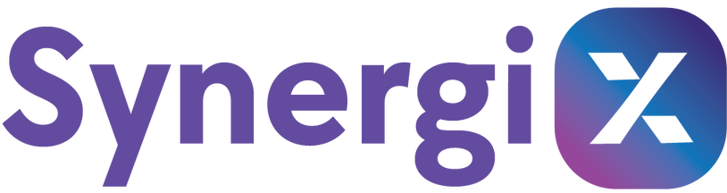







Captives are meant to evolve.
Excess risk should mature with them.
(412) 369-9696
synergix.insure

Slide 2


Synergix Re Enables Existing Captives the Ability To:
  Purchase excess coverage via captive insurance company
  Participate in underwriting profits earned at the excess level
  Collaborate with other policyholders (captives) on excess reinsurance, governance synergies, and market trends
(412) 369-9696
synergix.insure

Slide 3

The Med Stop Loss Captive Market is Evolving
  Group captives are proliferating
  Fronting carriers silently influence structure
  Incentives are drifting away from captive investors/insureds
(412) 369-9696
synergix.insure

Slide 4

Ideal Synergix Members
  Established captives
  Capital stable programs
  Managers aligned with long-term discipline
(412) 369-9696
synergix.insure

Slide 5

Transparency is Non-Negotiable
  Bordereau
  Ratios
  Methodologies
  Education and collaboration
    Synergix shareholder meetings
      WCF/CICA
      SIIA
      Nevada annually
(412) 369-9696
synergix.insure

Slide 6


The Current Med Stop Loss Re-insurance Structure
Admitted Carrier “Front”
“Theirs”
$375K
$390K
$400K
$375K
$350K
$360K
$350K
$360K
“Ours”
Captive Layer, $300,000
$90K
$100K
$75K
$60K
$60K
$75K
$50K
$50K
“Mine”

Slide 7
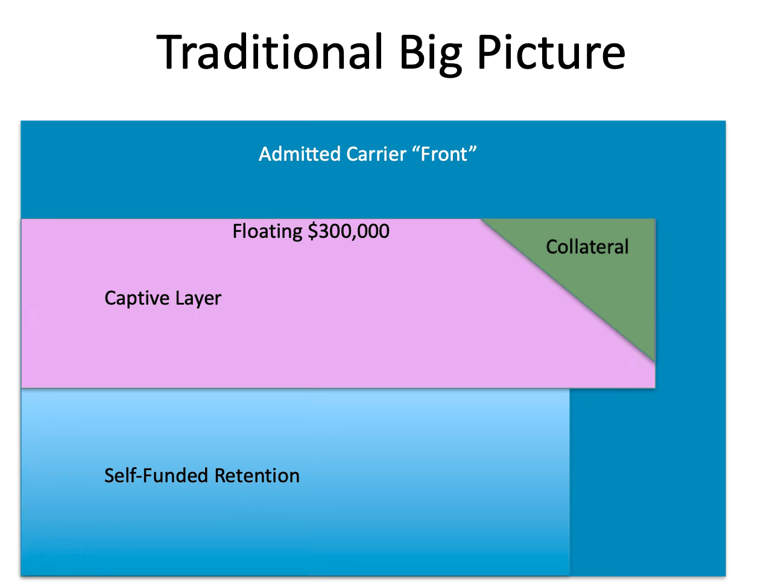
The Traditional Big Picture

Slide 8
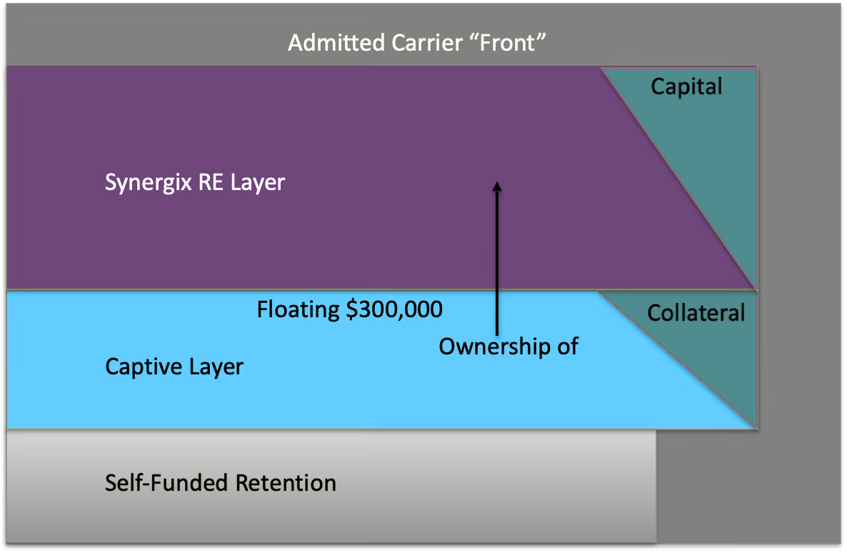
The Big Picture with Syngergix Re

Slide 9
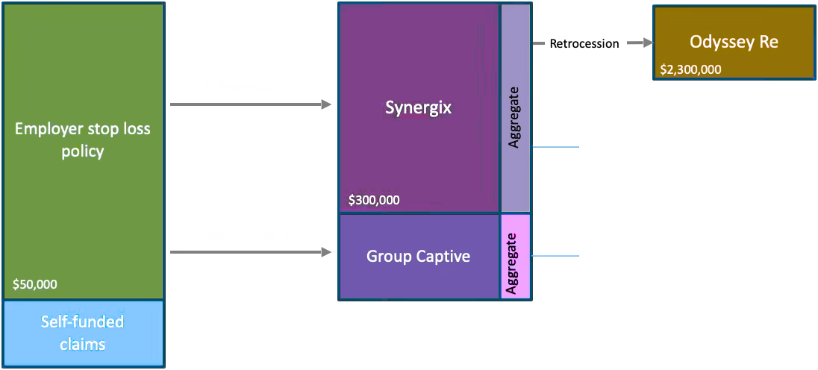
Syngergix Re - Fronted Structure, capped
Synergix aggregate provided by Odyssey Re across the Synergix book. Odyssey Re attaches above Synergix $2 million spec layer ($2.3m ground up for MedTrans) and an aggregate amount if required.
Captive aggregate provided by fronting company for a charge. Part of reinsurance agreement 1. The captive’s underwriting obligations limited to 125% of net ceded premium.
Option for Synergix to provide the aggregate cap to the group captive and capture that premium.

Slide 10
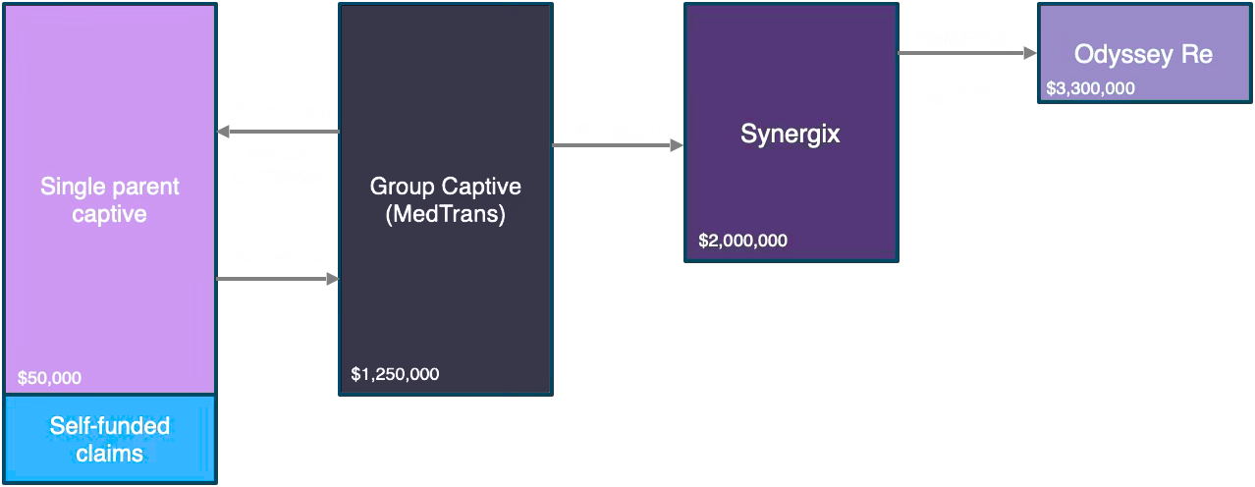
Syngergix Re - Direct Structure
Each single parent cell issues the stop loss policy to the employer.
Pooled at MedTrans with cession back to cells for risk distribution purposes.
MedTrans retains $1,250,000 and buys reinsurance (retrocession) from Synergix. Synergix retains $2 million and buys excess coverage from Odyssey Re.
Risk passed through layers and dimensions. Accommodate agg and spec.

Slide 11

HOW The Tail Wags the Dog
  Fronting + excess bundling
  Carrier economics quietly shape captive behavior
  Efficiency gives way to convenience

Slide 12

Fronting & Excess Fees
  When a front enters into a reinsurance agreement with a captive, the carrier will charge:
    Fronting fee – Cost (5-10%) to ”rent” the carrier’s paper & administrative functions, such as underwriting, claims, accounting & tax
  Claims ceded back to carrier above captive retention – Premium expense for this ceded coverage.
  Sample: $300,000 excess retention limits
Why do you need a Front?

Slide 13
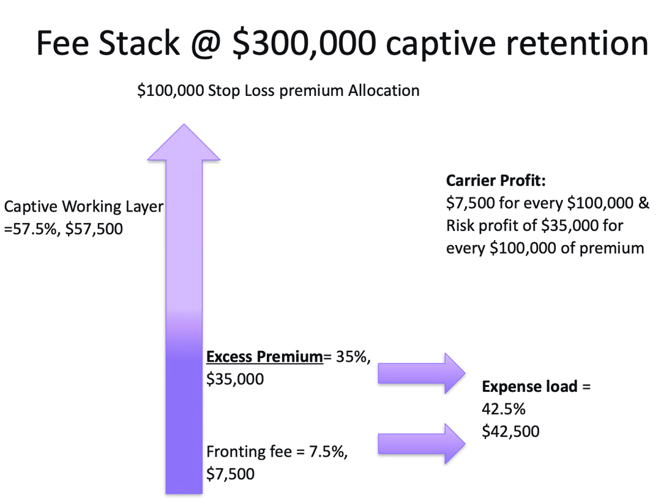
Fee Stack @ $300,000 Captive Retention

Slide 14

Interpretation of the Traditional Model
  Most structures empower carriers over the capital providers (captive participating insureds)
  A goal is for the captive to grow life count, which enables retention to increase.
  Since the fronting carrier prices excess, proper premium discounts may not occur because the carrier could strip potential underwriting profits.
As a result,
a captive behaves like insurance buyers
—
NOT
RISK TAKERS

Slide 15
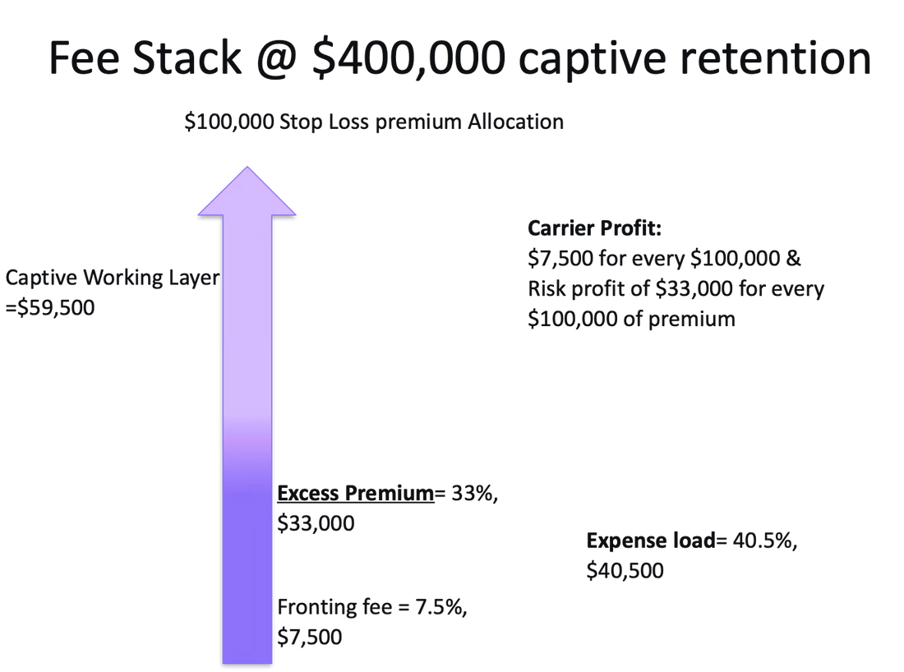
Fee Stack @ $400,000 Captive Retention

Slide 16
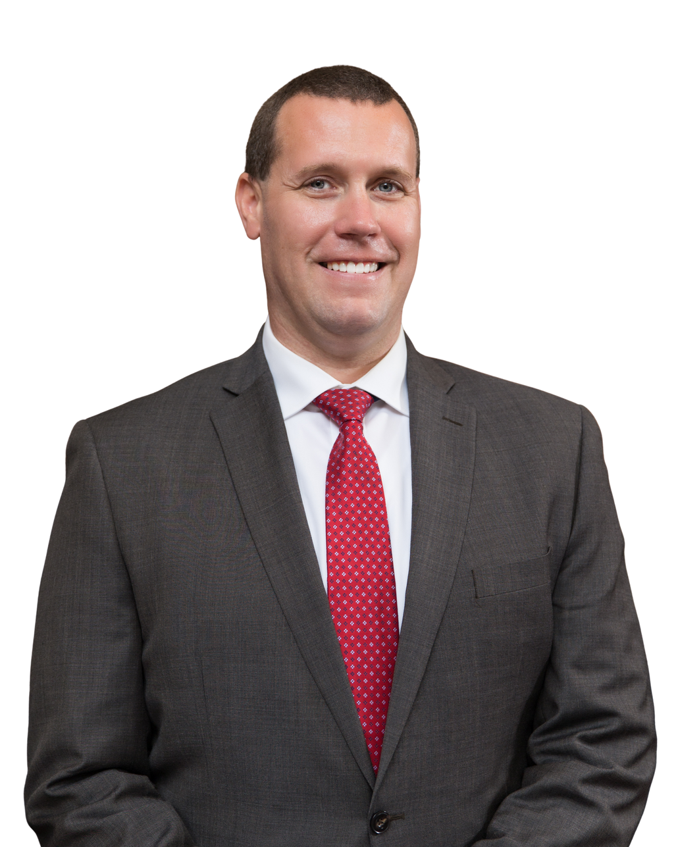
The Synergix Re Difference
  A policyholder-controlled mutual reinsurer
  NV-domiciled association captive
  Built exclusively for captives
  Common bond for captive collaboration
  Risk retained increases with scale
  Actuarially supported
  No growth for growth’s sake
(412) 369-9696
synergix.insure

Slide 17

Synergix Re Benefits
  Issues excess stop loss only to captives
  Attaches above captive retention
  Covers the next $2,000,000 per claim
  Claims in excess of $2,000,000 + Captive’s retention will retrocede to either:
    Fronting carrier already in place or
    Odyssey Re, Synergix’s excess carrier.

Slide 18

Synergix Re Background
  Reason #1 – Appropriate Excess Pricing
  medTRANS market experience
    2016 – no longer fronted
    Excess premium was reduced without explanation
      Excess of $250,000
        2015: Rate was ~ $42 PEPM
        2016: Rate was ~ $35 PEPM
  Discovered our fronting carrier was giving away fronting service and overcharged excess premium.

Slide 19

The Retention Question
  Large captives are retaining too little risk
    Not currently priced attractively
  15k–50k lives with $300k–$500k retentions
  That is not risk-taking behavior
    Why?

Slide 20
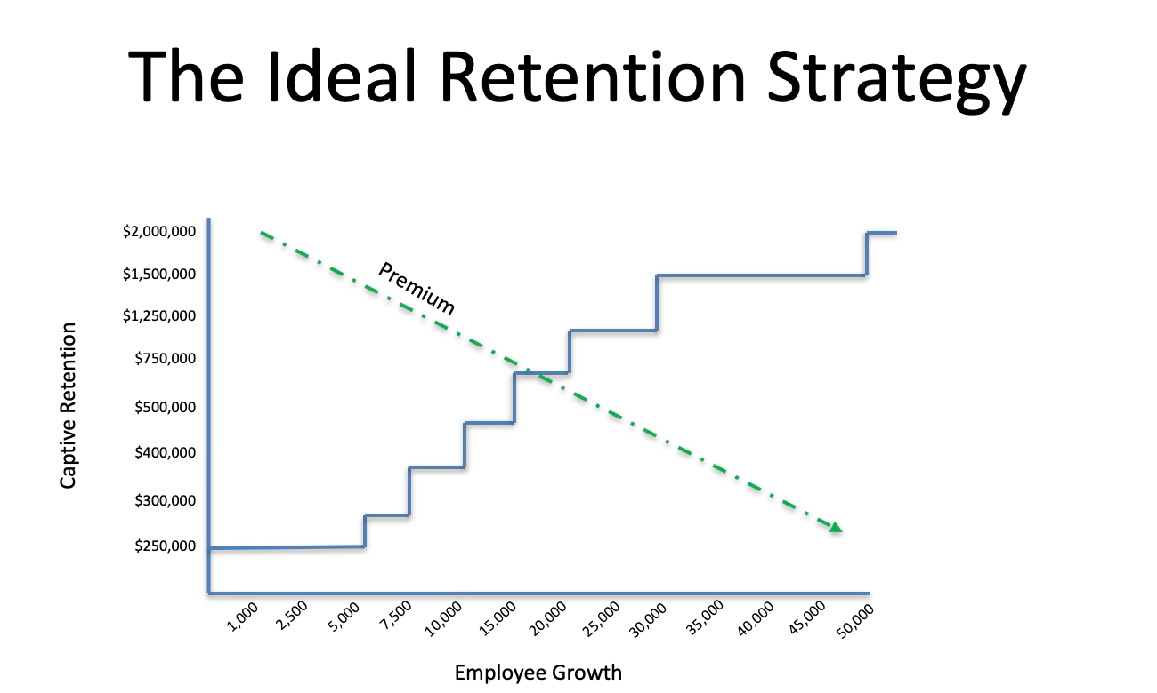
The Ideal Retention Strategy

Slide 21
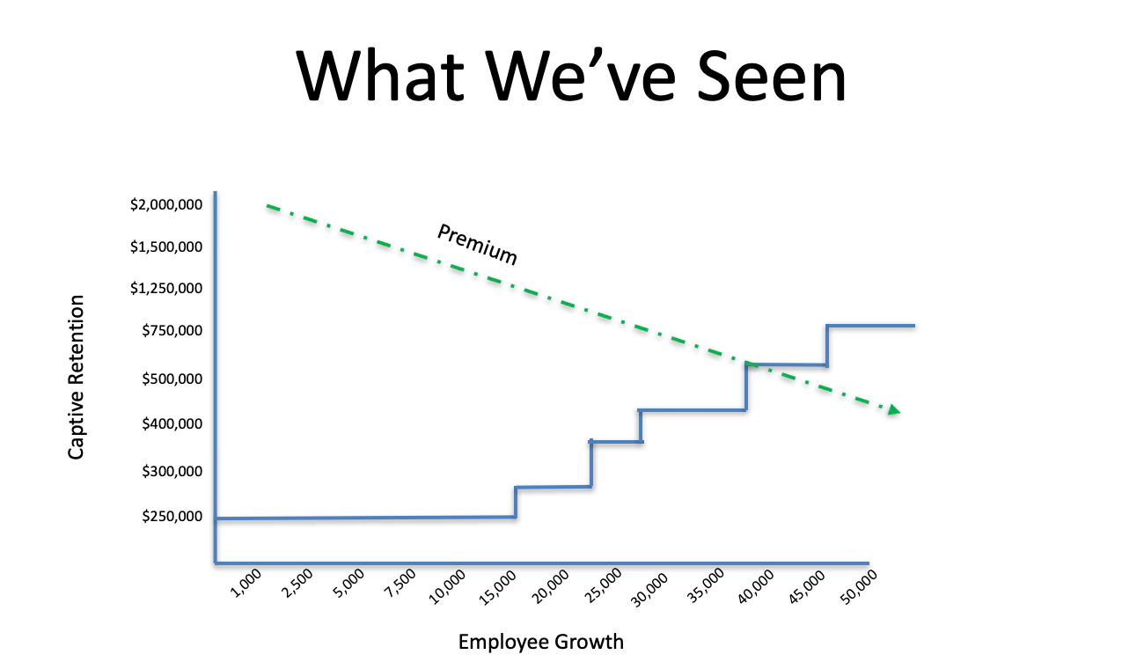
What We’ve Seen

Slide 22

The Math Told the Same Story
  medTRANS paid millions in premium
  Very, very low breach rates
  Inefficiency of premium pricing compounds over time

Slide 23

The Strategic Goal
Reason #1
  Bring excess pricing back in line
Reason #2
  Allow the captive to take back lost underwriting profits at the Excess layer

Slide 24
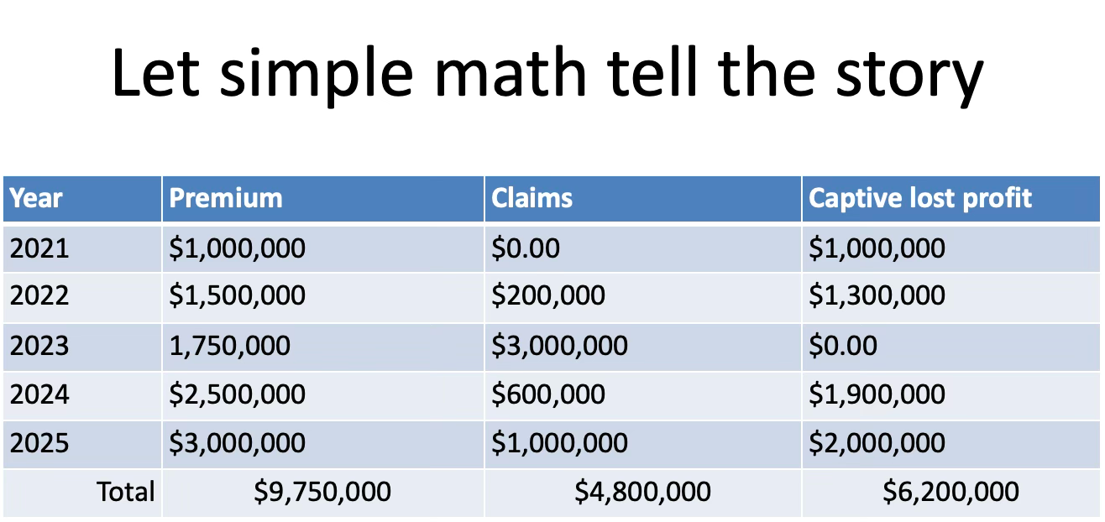
Let the Simple Math Tell the Story

Slide 25

Synergix Efficiency
  Highly efficient model
  Since Synergix does not have a profit motive G&A expense is set at 10%
    That is ~ 3x lower than admitted carriers
  Policyholder benefits
    Better premium pricing & greater propensity to generate underwriting profits

Slide 26
Strategic Goal
Bring excess pricing back in line
Underwriting profit generation
Reason #3
  Captive to captive collaboration
  We are profound believers of captive insurance.
  The captive profession stands to be stronger together than competing.
    Let’s collaborate on governance, stop-loss policy terms, health plan service provider compliance

Slide 27
Strategic Goal
  Let’s make sure our clients are benefiting from a unified standard of excellence.
    Network contracting experience.
    Health plan service provider experience.
    Medical stop-loss policy language collaboration
  Ideal client standards & opportunities

Slide 28




Synergix Business Agreements
Captive Manager
Legal Counsel for Synergix Business Affairs
Auditor
Actuary Services

Slide 29

Synergix Business Development
  Group, reinsurance captives
  Group, Direct writer captives
  Single-parent reinsurers
  Single-Parent Direct writers

Slide 30

Synergix Expectations
Anticipated response from admitted carrier market:
Need to rob Peter to pay Paul, OR not willing to engage
    For existing reinsurance captives using the big 5 carriers, they will not be willing to give up the excess layer (very profitable)
      Continue to prevent your captive from maximizing underwriting profits
      If your fronting fee is 6% today and your retention is $300,000, when you add Synergix, the fronting fee may go to 10%.
      That maybe a great deal for YOUR captive

Slide 31

Synergix Expectations, cont’d
Anticipated response from admitted carrier market:
  If YOUR reinsurance captive continues being a reinsurer and your current carrier will not allow you to cede to Synergix; then
  We can plug you into our preferred fronting carrier.

Slide 32
Complete Captive Management Services
  Serve as the captive manager
  Underwrite for Synergix
  Issues the Excess Policy
  Performs premium receivable accounting
  Claim processing/payments

Slide 33

Considerations with Front
Potential concerns about fronting claims vetting:
  Washing their hands of claims.
  Funds withheld & release timing.
  Bordereau reporting.

Slide 34

Synergix Concept
  A captive for captives
  A governance solution for excess risk
  A better alignment of capital and control

Slide 35
Risk is Real
  Feasibility Studies
    Thousands of models tested
    Defined capital tolerances
    Selective participation
  If claims exceed cash:
    Cash calls
    Or delayed funding
  This is insurance—not a product wrapper

Slide 36

Synergix Commitments
  Not to insure immature captives
  Never ignore retention discipline
  Nor, Say yes, too easily

Slide 37

Capital and Ownership
  4:1–5:1 premium to surplus
  Capital buys equity
  Profits tied to performance

Slide 38

Exit Philosophy
  Non-renewal always allowed
  Capital held 2 years
  Profits released on a long-term horizon

Slide 39

Next Steps with Syergix
Interested in discovering next steps?
Step One:
Submit all underwriting data to rfp@synergyx.insure:
  Census
  High-cost claimants, excess of 50% of your captive’s retention
  Desired captive retention
  We will issue an excess only PEPM rate your fronting carrier can build into their premium.

Slide 40
Synergix is not here to disrupt captives.
Synergix is here to empower captives to perform like risk-takers again.
(412) 369-9696
synergix.insure

